Slide 1

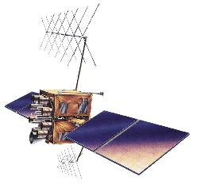
Geographic Information Systems
By: Gezahegn Gr.
Course Code: LAS2024/25
ESTC: 7 ECTS
gezahegngirma@hu.edu.et or gezahegngirma.eshete22@estudiantes.uva.es

Slide 2

U1. Introduction to GIS
“Everything that happens, happens somewhere .
Knowing where something happens is critically important”
2

Slide 3
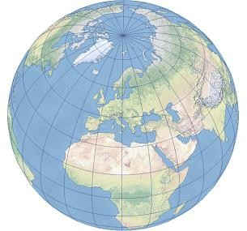

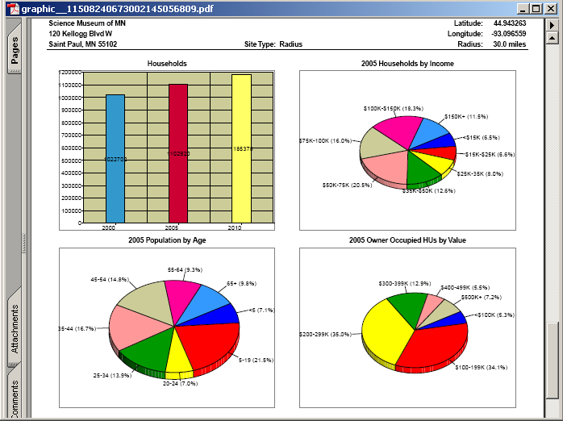

G>>Geographic
⇒ about the Earth
G I S
I>> Information
⇒ database, descriptions of things/objects
S>> System
⇒ Working together by
using technology

Slide 4

What is a GIS?
GIS is a system designed to capture, store, manipulate, analyze, manage, and present all types of geographical data (ESRI, 2009).
GIS is a computer-based system, which provides the following four sets of capabilities to handle georeferenced data:
Data capture and preparation
Data management (storage and maintenance) Data manipulation and analysis
Presentation
4

Slide 5
cont. What is a GIS?
GIS is an organized collection of computer hardware, software, geographical data, and personnel designed to efficiently capture, store, update, manipulate, analyze and display all forms of Geographically referenced data (Burrough,1998).
5

Slide 6
Types of Questions GIS can Answer
Where is it? ( location indicator) What is at? ( at a specific location)
What has changed? (changes over time at a specific location)
What patterns and relations exist? (measuring and quantifying relationships between variables)
What if …? ( modeling or assumption)
6

Slide 7
Data vs information
Data: any collection of related facts; unorganized and unprocessed
Information: data that have been processed to be useful; it provides answers to "who", "what", "where", and "when" questions.
Information can only come from accurate data (GIGO).
7

Slide 8
Activity 1
For self-evaluation
why GIS for land administration?
Which capability of GIS is prominently important for land administration?
Clearly define GIS as a science and as a system
Where are you now?
8

Slide 9
End of unit one

Slide 10
U2. Components of GIS
Components of GIS: They are six Hardware
Software Data People Method
Network Communication

Slide 11
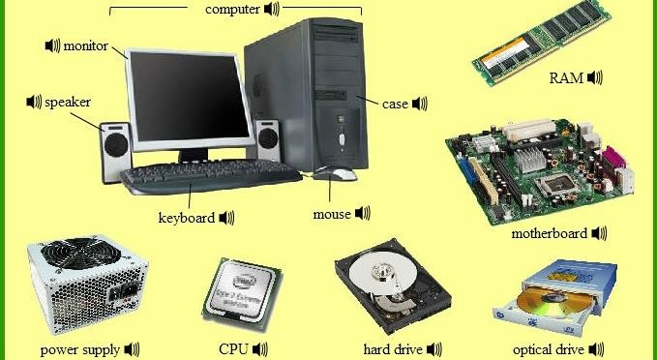
2.1. Hardware

Slide 12
2.2. Software(SW)
It’s used to create, manage, analyze, and visualize geographic data.
Based on functionality: Desktop GIS
Spatial database management system(SDMS) WebMap Server
Server GIS
WebGIS Client( tin and teck) Mobile GIS
Literaries / extensions

Slide 13
GIS SW Categories based on accessibility mode
Commercial GIS SW Must be paid for license and extension tools
ArcGIS (Esri)
Geomedia (Hexagon Geospatial) MapInfo Professional (Precisely) Global Mapper (Blue Marble) Manifold GIS (Manifold) Smallworld (General Electric) Bentley Map
MapViewer and Surfer (Golden Software) Maptitude (Caliper Corporation) SuperGIS (Supergeo Technologies) IDRISI (Clark Laboratories)
https://gisgeography.com/commercial-gis-software/

Slide 14
Open and free GIS software
It allows the user to inspect the source code and provides a high
level of control of the software's QGIS GRASS GIS
Whitebox GAT gVSIG
ILWIS SAGA GIS
GeoDa MapWindow
uDig OpenJump
https://gisgeography.com/free-gis-software/

Slide 15
3.Data
Data is the heart component of GIS
Spatial data can be categorize into three major types
Spatial data is location information of occurrence or existential
phenomenon of specific location
None spatial data are an explanation of spatial data
Meta data its data about data
1
9

Slide 16
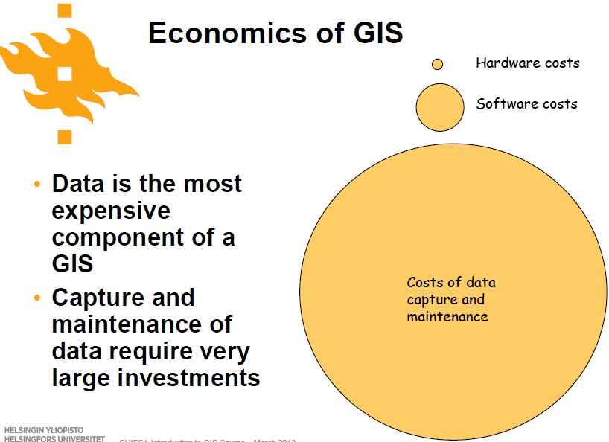
Data Cont’d
Includes both spatial and non-spatial data on which GIS operations are performed to derive new information.
Spatial data from various sources such as Remote sensing images, Aerial Photographs or Map Data can be integrated with corresponding non-spatial data in GIS.
Perhaps the most time consuming and costly aspect of initiating a GIS is creating a database.

Slide 17
Thechnically
spatial data can be categorized into three classes
Event data
Fixed-location data
Exhaustive spatial data
20

Slide 18
Event data
An event is “something” occurred within an observation
Area
Volcanoes within a country Trees in a forest
Crimes in district
Traffic accident occurrence in city
21

Slide 19
Fixed location spatial data
consist of one or more variables sampled at a number of fixed locations defined through their spatial coordinates
Examples:
Precipitation or temperature recorded in a series of meteorological stations
sampled in specific locations of a mineral deposit
Pollutant concentrations in a series of soil samples
23

Slide 20
Ehaustive spatial data
It includes the value of a variable of interest in the entire area of the study. The variable can be either continuous or discrete
Digital elevation maps Aerial photographs Satellite images Polygonal thematic maps
24

Slide 21
Vector vs. Raster Data Models Both types of data are very useful, but there are important differences:
Vector Data Model
relatively low data volume
faster display
can also store attributes
less pleasing to the eye
does not dictate how features should look in the GIS.
Raster Data Model
relatively high data volume
Slower display
has no attribute information
more pleasing to the eye
inherently stores how features should look in the GIS.

Slide 22
4. People
The human who performs GIS tasks. The group of people makes a team.
There are three major categories of roles such as exploration level, Intermediate level, and manager level
1. Exploration level
GIS Editor
GIS Technician GIS officer Draftsman
Jr. GIS Analyst Digitizer
Jr. GIS Web Developer Spatial Data Handler Jr. Spatial DBA
Jr. GIS Front-End Developer Data extraction specialist
25

Slide 23
2. Intermediate Level titles
GIS Analyst
GIS Data Engineer
Spatial Database Administrator GIS Front-End Developer
GIS Data Capture Specialist GIS Mapping Technician GIS Business Analyst
26

Slide 24
3. Manager Level titles:
Chief GIS officer (CGO) GIS Manager
GIS supervisor GIS Specialist GIS Team Lead
GIS product manager
Geospatial Subject Matter Expert Geospatial Scientist
27

Slide 25
5. Methods or Procedures
Procedures or methods are the techniques to perform GIS workflows. Methods come from mother sciences such as
statistics mathematics
physics and other sciences
28

Slide 26
Cont.. Procedures or Methods
Procedures include how the data will be retrieved, input into the system, stored, managed, transformed, analyzed, and finally presented in a final output.
The procedures are the steps taken to answer the question need to be resolved.

Slide 27
Functionality of GIS
GIS is a computer based system that provides four sets of capabilities (functions) to handle geo-referenced data:
data capture,
data management (storage and retrieval)
data manipulation and analysis,
data output.

Slide 28
6. Network and Communication
Cloud computing is a revolution in the GIS industry. It can only be possible by Network and communication. Sharing is the crux of all doings. So, the network and communication are vital components of GIS.
29

Slide 29
Activity
For self-evaluation
Case: Assume there will be a conservation and rehabilitation plan at Bale park by having this in mind!
List the needed GIS data with their types
Who could be part of the project” which type of expert” justify
why!
Which software would you like to recommend and why?
By which mechanism can you present the result?
what do you think about the ” metadata” of the project?
How do you deeply understand the course?
30

Slide 30
End of unit two

Slide 31
U3. Data Models
In order to visualize natural phenomena, one must first determine how to best represent geographic space.
Data models are a set of rules and/or constructs used to describe and represent aspects of the real world in a computer
The basic units of spatial information are points, lines (arcs) and polygons.
A GIS data model enables a computer to represent the real geographical elements as graphical elements.
32

Slide 32
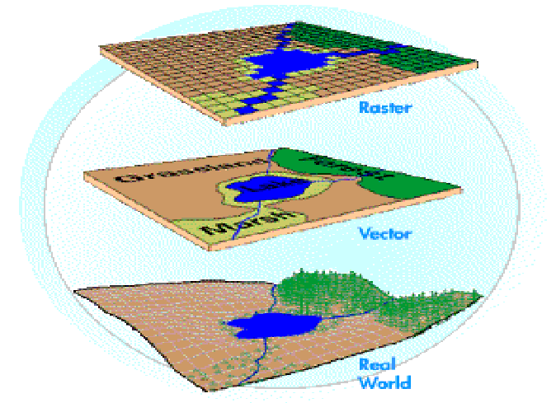
GIS Data Models
Data Models

Slide 33
Vector data model
vector data model represents geography as collections of points, lines, and polygons
Points are zero-dimensional objects that contain only a single-
coordinate pair(For example, pole, ditch, and …… )
Lines are one-dimensional features composed of multiple, explicitly
connected points ( For example, Road, River, and …)
polygons are two-dimensional features created by multiple lines that loop back to create a “closed” feature. (For example, city boundaries, lakes, soil associations, and vegetation communities
33

Slide 34
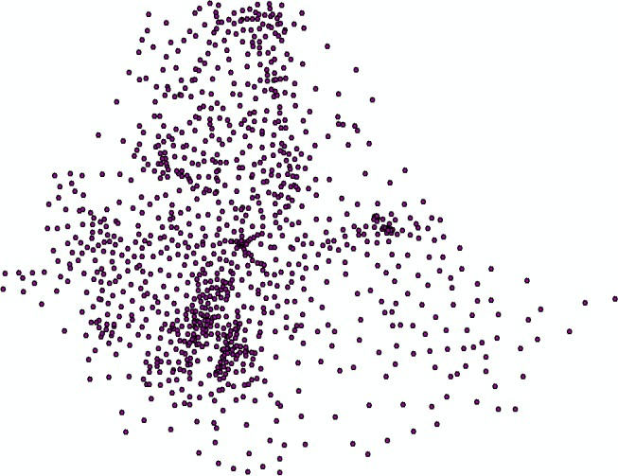
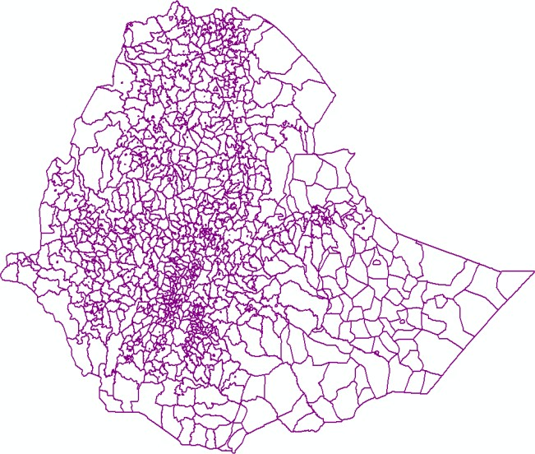
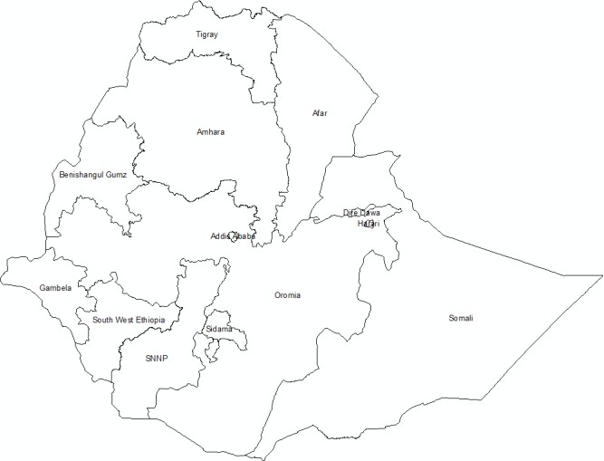
Cont…
Point
line
Polygon

Slide 35
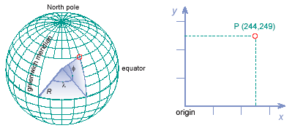
Vector Representation
Vector representations explicitly associate geo-references with geographic phenomena.
A georeference is a coordinate pair from some geographic space and is called vector.

Slide 36
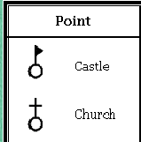
Point Representation
Point are defined as single coordinate pairs (x, y) in 2D or coordinate triplets in 3D.
Points are used for objects with shapeless or size less single locality features.

Slide 37
Point Representation Cont’d
The points are represented by pair of x, y coordinates and a label (name):-
Example: Location of oil wells,
location of rain gauge stations
electrical poles
Bore wells
Hospital
School
etc.
Oil well

Slide 38
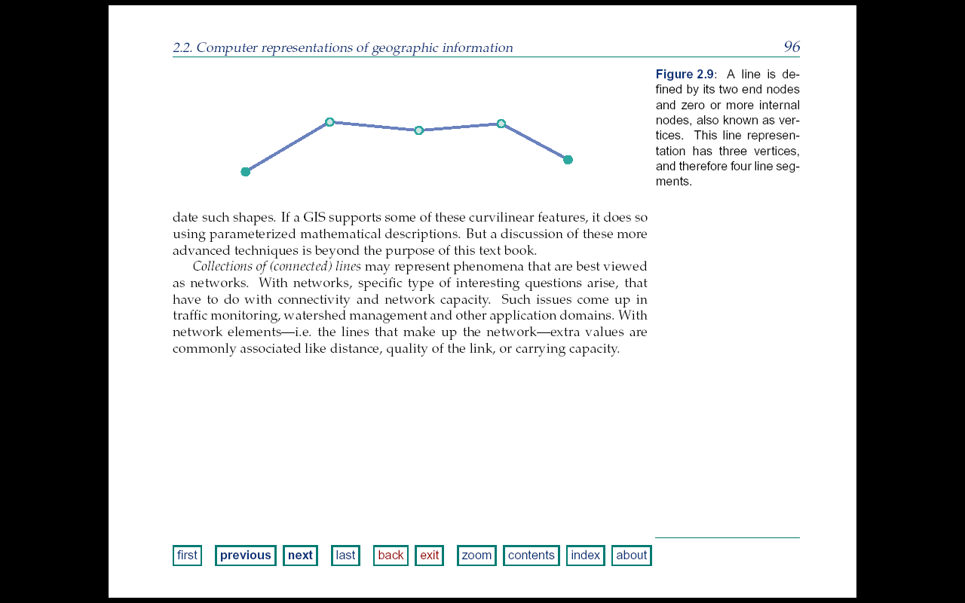
Line Representations
Line data are used to represent object, such as roads, railroad, canals, rivers and power lines.
In some software, line can be called arc or edge.
The straight parts of a line b/n 2 consecutive vertices or end nodes are called line segments.
GISs store a line as a simple sequence of coordinates of its end nodes and vertices (assuming all segments are straight).
Collections of (connected) lines may represent phenomena that are best viewed as net works.

Slide 39
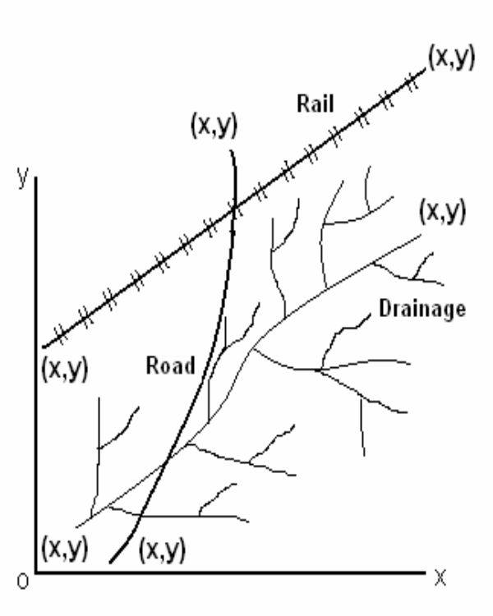
Line Representations cont’d
Linear features on the map or earth surface can be represented by lines/polylines in GIS database.
Lines consists of series of x, y coordinates with starting and ending points and a label
Line features will have length attributes.
Ex. Roads, drainage, rail, etc.

Slide 40
Area Representations
Area objects are stored using a vector approach, the usual technique is to apply a boundary model.
Each area feature is represented by some arc/node structure that determines a polygon as the area’s boundary.
Areas are represented by their boundaries and each boundary is a cyclic sequence of line features.
But this is a huge data and difficult to make analysis.

Slide 41
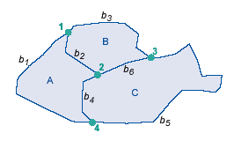
Area Representations

Slide 42
3. Area Representations Cont’d
Fig. Polygon Features
Features with extended area can be represented by polygons
Polygons are closed features designed by a set of linked lines.
Polygon will have starting and same closed coordinate (x,y) and a label.
Polygons will have area and perimeter attributes.

Slide 43
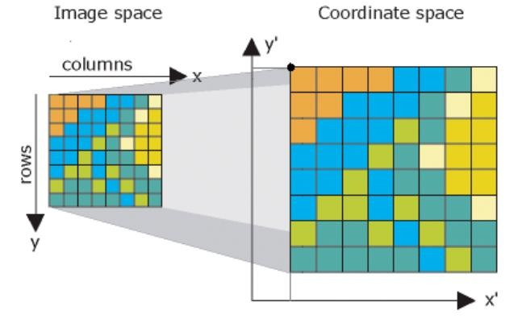
Cont…
Raster data model represents geography as cell matrixes that store
numeric values
They are geographic features by dividing the world into discrete square or rectangular

Slide 44
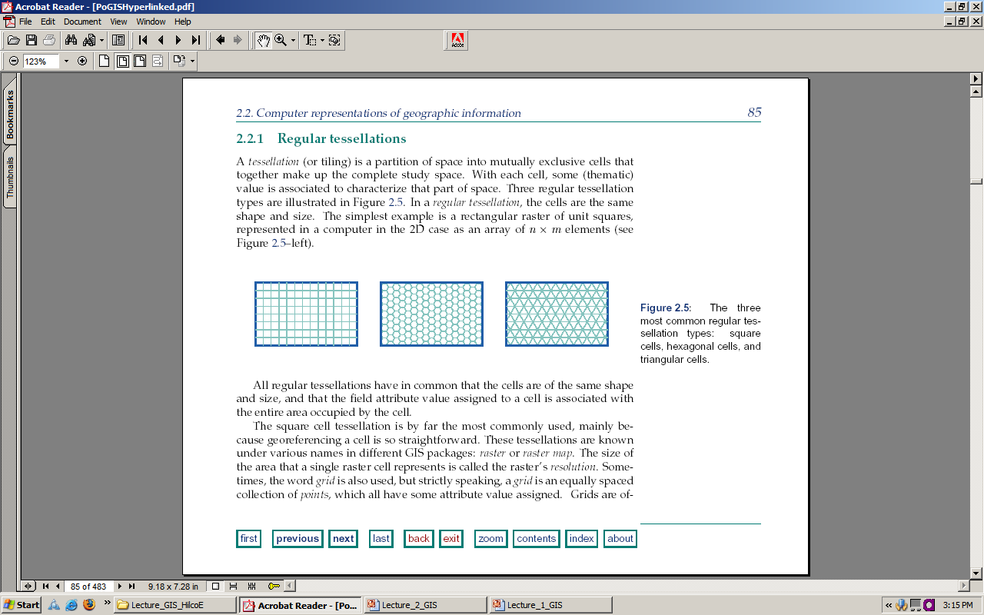
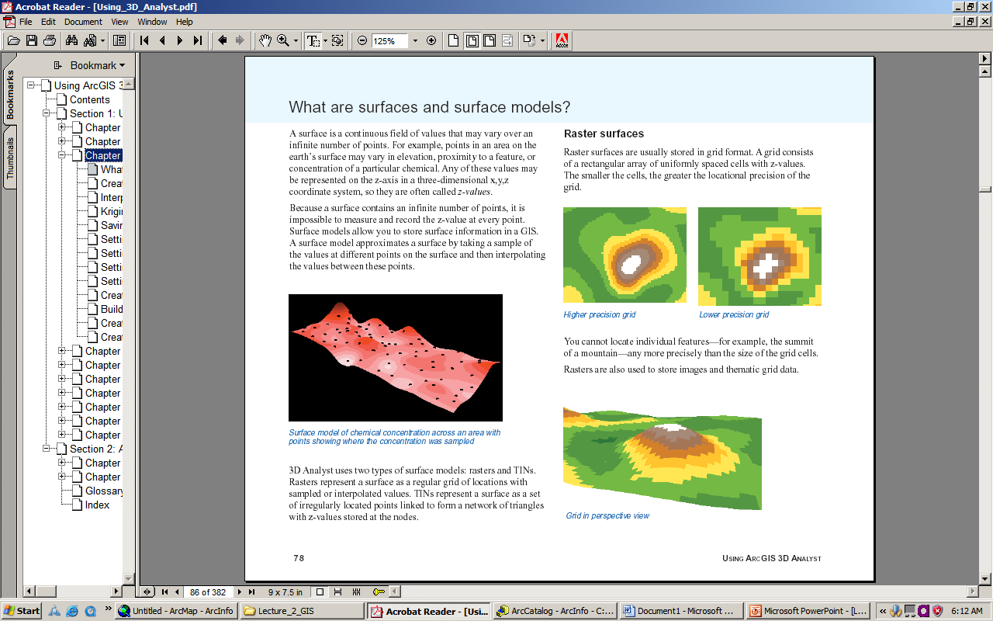
Raster Representation
Regular tessellation
Square (pixel), hexagonal and triangular cells
A tessellation is a partition of space into mutually exclusive cells that together make up the complete study space.

Slide 45
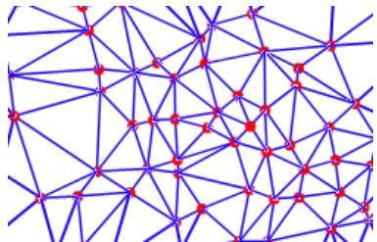
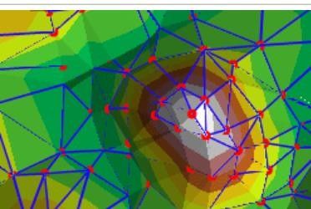
Triangular irregular networks (TIN)
TIN data model represents geography as sets of contiguous, nonoverlapping triangles
TINs are a form of vector-based digital geographic
They are represent surface morphology

Slide 46
Assignment one
What are the advantages and disadvantages of GIS data model(
Vector, Raster, and TIN) with supportive examples? What are the sources of those GIS data model Note:
The report should be 2 pages minimum and 4 pages maximum
It has asset value if the source documents could be cited with their bibliography
either soft copy or hard copy report mode is possible but in the case of hard copy, it should be clear and neat with good handwriting.
Grammar, coherence, and punctuation are appreciable
TIP and HINT “four data model in GIS “: Researchget
Direct copy might be resulted in zero mark!!!
Submission date with in 10 days from the day its given ahead!!!
ggirma2021@gmial.com
Good luck!!!
3
7

Slide 47
End of unit three

Slide 48
U4. Coordinate System and map
A coordinate system is a system that uses numbers or coordinates to determine the position of a point or geometric element within a geographic framework.
A coordinate system is also used as a reference system to represent locations of geographic features, observation points, GPS (Global Positioning System) points, and imagery within this framework.
The simplest coordinate system consists of coordinate axes oriented perpendicularly to each other, known as Cartesian coordinates.
Depending on the type of problem under consideration, a specific type of coordinate system may be better to use than others

Slide 49
Coordinate system …
Coordinate system and spatial reference system
Coordinate System is the most general term for a system that
includes coordinates.
A spatial Reference System is a coordinate system used to reference spatial information, typically to the surface of the earth. These two terms, and their acronyms, are used interchangeably in GIS.
A data structure cannot be considered geospatial unless it is accompanied by coordinate reference system (CRS) information, in a format that geospatial applications can use to display and manipulate the data correctly.
CRS information connects data to the Earth’s surface using a
mathematical model.

Slide 50
Types of the coordinate system
Two types of coordinate systems or spatial reference systems are commonly used:
Geographic coordinate system and Projected coordinates system

Slide 51
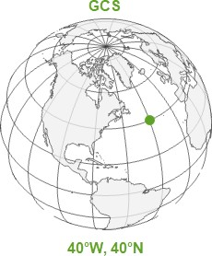
Geographic coordinate system
A geographic coordinate system (GCS) is a reference framework that defines the locations of features on a model of the earth.
A GCS is round, and so records locations in angular units (usually degrees).
The geographic coordinate system is necessary for data to know where exactly on the earth’s surface it is located (Smith, 2020).

Slide 52
Cont…
Geographic Coordinate Systems are defined by a Datum.
A Datum essentially defines the Globe Model of the coordinate system
Defines a starting point (i.e. where is (0, 0) in particular which longitude is defined to be 0°?), so the angles reference a meaningful spot on the earth.
Defines the position of the spheroid relative to the center of the earth and therefore the origin and orientation of latitude and longitude lines.
A point is referenced by its longitude and latitude values. Longitude and latitude are angles measured from the earth’s center to a point on the earth’s surface.

Slide 53
Advantages and disadvantages of the geographic coordinate system
Advantages
Disadvantages
The location of points or objects are exactly referenced to the earth’s model
No distortions of the properties of geographic objects on the chosen model
The position of object is measured in degrees, which makes it difficult to measure distance and area

Slide 54
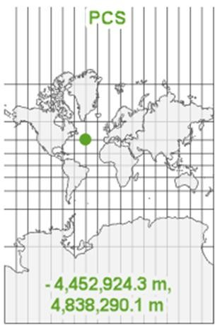
Projected coordinate system
A projected coordinate system (PCS) is a GCS that has been flattened using math (the projection algorithm) and another parameter. It tells the data how to draw on a flat surface, like on a paper map or a computer screen (Smith, 2020).
PCS records locations in linear units (usually meters).
Projected coordinate systems include a
projection.
A Projection is a mathematical transformation of the angular measurements on a round earth to a flat surface (i.e. paper or a computer screen).
45

Slide 55
Why map projection?
Once your data knows where to draw, it needs to know how. The earth’s surface and your GCS are round, but your map and your computer screen are flat. That’s a problem.
You can’t draw the round earth on a flat surface without deforming
it.
Imagine peeling an orange and trying to lay the peel flat on a table. You can get close, but only if you start tearing the peel apart. This is where map projections come in. They tell you how to distort the earth and how to tear and stretch that orange peel so the parts that are most important to your map get the least distorted and are displayed best on the flat surface of the map (Smith, 2020).
46

Slide 56
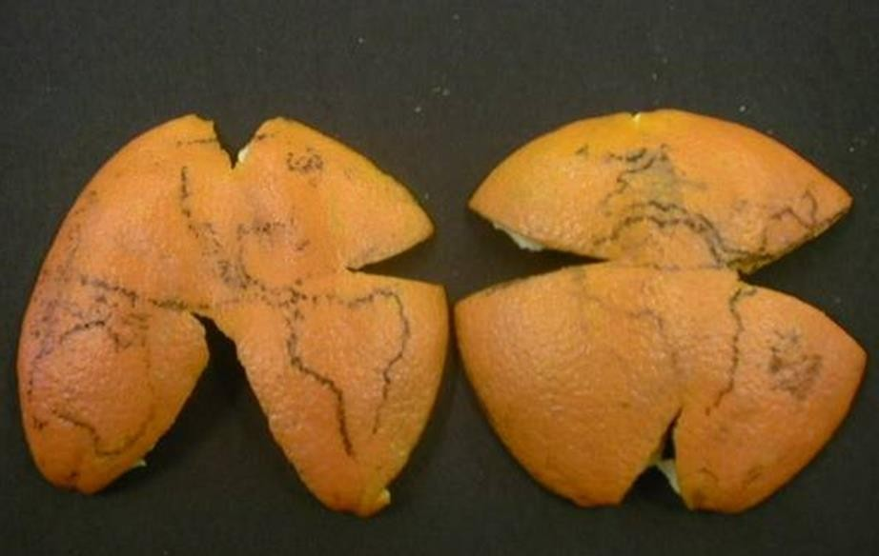
How projection????
47

Slide 57
Advantages and disadvantages of projected coordinate system
Advantages
Disadvantages
Easy to display objects on flat plane or paper.
Easier to measure distance and
area of objects.
We can only see the 2-D figure of the geographic object.
Distortion of shape, area, scale
during the projection.

Slide 58
Why map projection?
A map projection is one of many methods used to represent the 3- dimensional surface of the earth or other round body on a 2- dimensional plane in cartography (mapmaking) (Dempsey, 2002).
The creation of a map projection involves three steps in which
information is lost in each step:
Selection of a model for the shape of the earth or round body (choosing between a sphere or ellipsoid)
Transform geographic coordinates (longitude and latitude) to plane
coordinates (eastings and northings).
Reduce the scale (in manual cartography this step came second, in digital cartography it comes last)

Slide 59
How projected coordinate systems work to locate positions?
In a projected coordinate system, locations are identified by x, y coordinates on a grid, with the origin at the center of the grid.
Each position has two values that reference it to that central location.
One specifies its horizontal position and the other its vertical
position.
The two values are called the x-coordinate and y-coordinate.
Using this notation, the coordinates at the origin are x = 0 and y = 0. on the left figure, the values (-4452924.3, 4838290.1) indicates the location (x, y) of the green point. The negative value indicates that the point is to the left (west) of the central y axes indicating negative x values.

Slide 60
GCS Vs PCS
GCS
PCS
Objects are located on the 3-D model of the Earth
Uses longitude and latitude to locate position
Position coordinates are measured in degrees Distance and area are not easy to measure Objects are on the reference model of the
earth, so the properties of the object do not change
Representation of the object on 2-D model of the Earth
Uses eastings (x) and northings (y) to locate position of objects
Position coordinates are measured in meter Easier for distance and area measurement When projecting from 3-D to 2-D, some
properties of the object distorted.

Slide 61
Datum
The datum is part of the GCS that determines which model (spheroid) is used to represent the earth’s surface and where it is positioned relative to the surface (Smith, 2020).
A datum is a reference from which spatial measurements are made. In surveying and geodesy, a datum is a set of reference points on the earth's surface against which position measurements are made, and (often) an associated model of the shape of the earth (reference ellipsoid) to define a geographic coordinate system (Bolstad, n.d.).
A datum in general is a reference point, surface, or baseline from which measurements are made. Naturally, there needs to exist consistent and standard regional or global reference frames for locating features on earth.
52

Slide 62
Types of Datum
Vertical datums are used as a reference (zero surface) from which
elevations and depths are measured.
Vertical datums are either tidal, based on sea levels, or geodetic, based on the same ellipsoid models of the earth used for computing horizontal datums.
In the past, datums were measured by survey control points using level bars and optical surface measurement tools. Today, vertical measurements are used via GPS, laser, and satellite (“Datum,” n.d.).

Slide 63
Horizontal datums
Horizontal datums act as base reference for measuring locations on the surface of the Earth. We use it to measure North and South (latitude), and to measure East and West (longitude).
Both of these reference frames (datums) are dependent on the way
the size and shape of the Earth is represented.
Different models of the Earth produce different datums, and therefore affect the value of a location's elevation and position (coordinates). Consequently, an understanding of the shape of the Earth and different ways of representing it is a prerequisite to any discussion of datums.

Slide 64
World wide
Ethiopia
Geographic coordinate system:
Geographic coordinate system
CRS: GCS_Adindan Datum: D_Adindan EPSG code: 4201
Projected coordinate system
CRS: WGS 84/UTM Zone 36|37|38N
Datum: WGS 84
EPSG codes: 32636|7|8
CRS: Adindan/UTM Zone 36|7|8N
Datum: Adindan
EPSG Codes: 20136|7|8
CRS: WGS 84
Datum: WGS 84
EPSG: 4326
EPSG stands for European Petroleum Survey Group.
WGS 84: World Geodetic System 1984

Slide 65
End of unit three

